Slide 1
GP & SF, March 26th 2015
Consumer Analytics Group,
Big Data Initiative

Slide 2
Agenda
Data Analytics and Big Data: An introduction……….………………………………………………
Analytic application: Company, Cluster, and Group Level……………………………………. …
Data Governance and Privacy: ..……………………………………………………...……………...
Group Consumer Analytics: Value Proposition ..…………………………………………………….
Appendix
3 - 5
6 - 9
10
11-13

Slide 3
Data Analytics: Enabling smarter decisions
Evolution of analytics entails building the decision capabilities for end-to-end decision management
“Nothing is more difficult, and therefore more precious, than to be able to decide”*
Decision Support
Decision Making
Sense and Respond
Predict and Act
Competitive Advantage
What is the best outcome?
What will happen?
Advanced Quantitative Science
Why did it happen?
Predictive Modeling
Optimization
Digital/E-commerce
Location based modeling
Social media text/voice analytics
Pattern recognition
Machine learning
Business Intelligence & Analysis
Clustering, Segmentation
Time Series Forecasting
Propensity Modeling
Trends,
Impact Analysis
Business Hypothesis
What happened?
Raw & Cleansed Data, MIS
Customer Database
Business Performance Dashboards
Analytics Maturity
*Source: Thinking, Fast and Slow – Daniel Kahneman

Slide 4
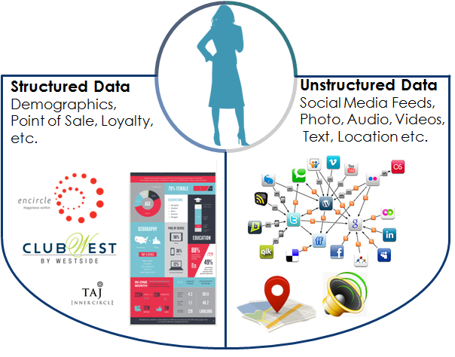
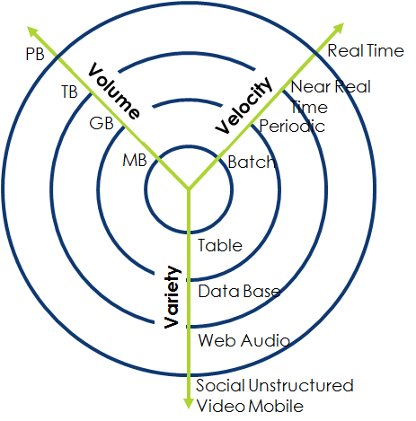
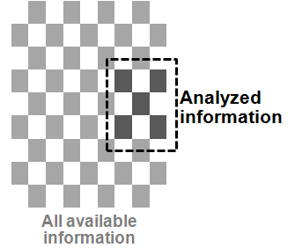
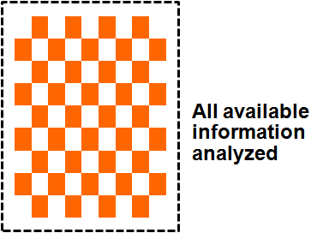
Big data: Driving the Evolution of Analytics
Big Data enables analysis of traditional as well as digital data, hence managers can measure and know radically more about their businesses
Key Sources and Characteristics of Big Data
Big Data Analytics
Traditional Approach
Big Data Approach
Analyze small set of data
Analyze all data

Slide 5
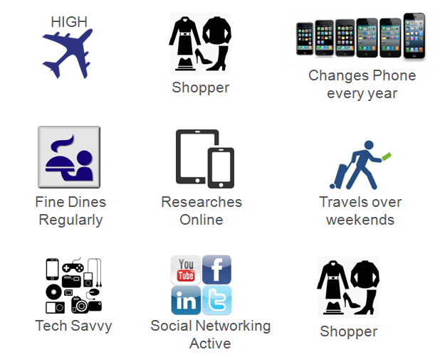






Big Data: Significantly better insights into our customers
Big data offers complete and comprehensive understanding of consumer preferences and behavior across various clusters
Travel Hospitality
Retail & CPG
Lifestyle
Preferences
In Store Shopper
Interests
Emerging Online Shopper*
Passions
Sentiments
Tele Services
Financial
Services
Advanced Online
Shopper**
1
2
3
4
Customer Information from multiple touch-points
Holistic perspective of all customer attributes
Develop Key insights and Predict behavior
Personalized offers that delight customers
*Low involvement categories like Books/ Movies etc. ** High involvement categories like Apparel/ Electronics etc.

Slide 6

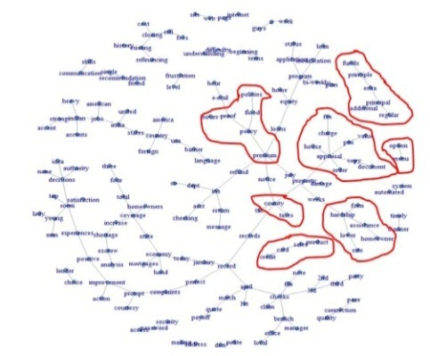
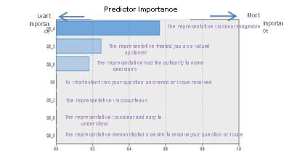


IHCL: Illustrative Example
Pin point the areas of customer discontentment and simultaneously generate key insights for higher allegiance
Analytics can help..
Illustrative Example: To Identify Drivers for NPS
Understand Preferences
(SPSS Text Analytics)
Analyzing Structured + Unstructured Data
Personalize & Standardize Experience
Personalize & Standardize Experience
Event triggers, Pricing, Personalization
VoC captured across web,
feedback forms, survey
Study Voice of Customer
Website enhancement
Reinforce representative knowledge
Institutionalize customer preferences
Customer Experience, Capacity Planning, Resource Utilization

Slide 7
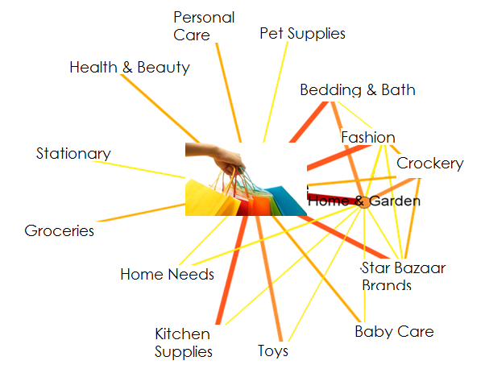
Star Bazaar: Illustrative Example
TCC can help retail companies drive revenue and profitability using internal and external data thereby driving synergies and opportunities of data monetization
Analytics can help..
Illustrative Example: Cross Basket Affinity to Drive Sales
High Affinity across some SKUs
Store Analytics
Marketing
  Network Optimization
  Store performance
  Sales effectiveness
  Resource Optimization
  Loss Prevention
  Customer Segmentation
  Market Mix Optimization
  Marketing Effectiveness
  Market Basket Analysis
  Recommendation Engine
Merchandizing
Customer Value & Loyalty
  Assortment Planning
  Price Optimization
  Cross-sell Opportunities
  Competitive Intelligence
  Promotion Testing
  Customer Insights
  Loyalty Management
  Customer Life time value
  Retention
Low Affinity across some SKUs

Slide 8
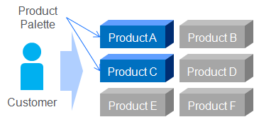
Finance and Insurance Cluster: Illustrative Example
Leverage all data sources to understand your customer and to roll the right offer across customer segments taking into account customer value
1. Understand your customers
2. Roll out segment specific strategies
3. Optimize decision at Customer level
1
2
Response
Price Sensitivity
Grow
Regular portfolio review by experts and limited wealth management support
Dedicated wealth manage-ment services
Profitability
Timing
Customer Value
Regular portfolio and support over telephone
Regular portfolio and support and discounts
Current
& Future
Customer
Value
Harvest
Customer Segments
3
4
Channel
Offer
Exit
Reminder offers through low cost channels
Offers through personalized channels
Channel
Low
Medium
High
Demographics & Psychographics
Risk Profile and Income Segment
Customer Value
Transaction Data
Channel Preference
Current Product
Holding
Notes:
Alter the circular view. Green, light green and amber

Slide 9

Benefits of Company, Cluster and Group level Analytics
Leverage the Group’s Business knowledge to increase customer base and size of wallet thus multiplying Revenues coupled with decreasing Operational Expenses
Tata Clusters
 | High Value
 | Medium Value
 | Low Value
 | No relationship
Retail
Hotels
Finance
More Customers,
Higher Wallet Share
Customers
4X
Less Customers,
Smaller Wallet Share
Revenue:
Cluster Level
Association
Customer Level
Relationship
2X
Revenue:
Impact
Retail
Hotels
Finance
@ | ++ | +
@ | + | +++
+ | +++ | @
++ | @ | +
+++ | ++++++ | +++++
@ | Little or no benefit
+ | Medium Benefit
++ | High Benefit
Analytic Operating Expenditure
Customers
Time
Cumulative Benefit
Notes:
Data Cleansing/linking, attribute creation, Marketing.

Slide 10








Data Privacy and Guidelines
Data Governance and Privacy framework is the key to accurately capture , store, and use the data assets to into decisions
Capture
Storage
Application
PURPOSE
About Customer: Action, Intent , Privacy Choices All customer touch points. |  | Data Governance: Store data , Access controls , retention |  | For intended purpose of Use : Servicing, Marketing, Risk Management, Analytics
Privacy Disclosure, Capture of Customer Data & Privacy Choices & Contact Preferences |  | Master Data Management Data Access, Storage Retention, Data Classification, Data Quality |  | Apply Customer Choices, Data Sharing & Contact Preferences
DATA GOVENANCE & PRIVACY
ACTIONS
Organization
Data Governance Council,
Mission, Vision, and
Organizational Responsibilities
People & Process
Roles & Responsibilities,
Decision Process workflow, Data Custodian
Operationalize
Business and Data Definitions, Rules, Policies, Taxonomy,
Data Management

Slide 11
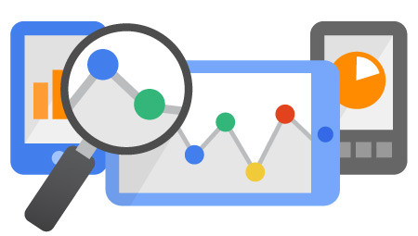













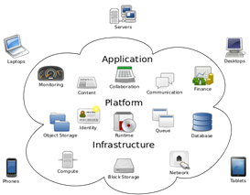


















The Indian Analytics Inc. landscape
Analytics vendors can be viewed in four broad clusters; several niche players have emerged recently
Annual avg. billing /resource
Analytics Solutions Providers
Pure-play Analytics Providers | IT Consulting Firms with Analytics Play
Generic Analytics Offerings across several verticals
18 - 24 L
Captive Units/ Boutique consulting
Limited specialization in few verticals
Consulting Firms with Analytics Practice | Niche Analytics Providers
24 - 40 L
Data Providers
Analytics Tools Providers
Thought Leaders
Specialization in 1 to 2 verticals
40 - 60 L
Internal
External

Slide 12



Consumer Analytics Group’s Positioning in the Analytics space
A phased hybrid approach of specialization and generalization to cover 6 clusters by Year 5
Hybrid Positioning Strategy
Cluster-wise approach
Target State
Target State
C1
C2
C1
C2
C1
C2
C3
C3
C3
C4
Path of
Specialization
Level of Sophistication
Level of Sophistication
C5
C6
C4
B. Path of
Generalization
C4
C5
C6
C5
C6
Y1 to Y3
Y3 to Y5
Y5+
C1: Retail & CPG C2: Financial Services
C3: Travel & Hospitality C4: Lifestyle
C5: Teleservices C6: Commercial
Presence in number of verticals

Slide 13


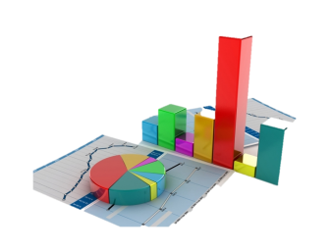
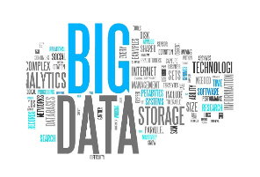
Unique Value Proposition and Enabler of Customer Centricity
Consumer Analytic Group will harness the power of data and analytics with enormous scale and speed to develop customer insights that will yield significant business gains
Cross Organization
Cross Cluster
Intelligence Access
Tata Group
Collaborate at the Group Level
Optimization
of Productivity
Analytic
Horsepower
Value Proposition
Centricity
Optimization
of Resources
Domain
Knowledge
Companies
Leverage Customer Data
Consumer Analytics Group
Harness Analytical Capability

Slide 14
Appendix

Slide 15
Data Analytics: Enabling smarter decisions
Evolution of analytics entails building the decision capabilities for end-to-end decision management
“Nothing is more difficult, and therefore more precious, than to be able to decide”*
Decision Support
Decision Making
Quantitative Sciences
Level of Maturity
Advanced Predictive Modeling
Business Analytics, Segmentation, and
Offer Strategy
List Management and
Recurring Analysis
Data Management,
Stewardship,
and, Business MIS
Type of Analytics
Select Outcomes
Data Cleaning/linking
Customer database
Business performance dashboard
Database marketing
Business Impact analysis
Portfolio Monitoring and management
Sales forecast
Price Management
Event triggers
Multi-Channel/Multi-Product Optimization
Digital/E-commerce
Location based modeling
Social media text/voice analytics
Pattern recognition
Trends, Business hypothesis
Customer segmentation
Clustering
Propensity modeling
*Source: Thinking, Fast and Slow – Daniel Kahneman

Slide 16
The Analytic maturity evolution
Evolution of analytics entails building the capabilities for an end-to-end decision management
Decision Support
Decision Making
Advanced Predictive
Modeling & Model Risk Management
Quantitative Sciences
Advanced Offer and Campaign Strategy Management
Business Analytics and Segmentation Management
Recurring Analysis, Campaign/List Management, Performance Measurement
Digital & Mobile Analytics
Social Media, Text & Voice Analytics
Pattern Recognition
Market Mix Modeling
Location Based Modeling
Advanced Optimization
Game Theory
Genetic Algorithms
Multivariate Time Series
Unstructured Analytics
Machine Learning
Data Management, Business MIS & Operational Reporting
Model Development
Model Audit & Validation
Model Tracking
Financial Forecasting
Simulations
Advanced Design-of-Experiments
EDA: Exploratory Data Analysis
Transaction Data Analytics
Trends and Univariate Correlations
Segmentation
Analysis of Data to Validate / Reject Business Hypothesis
Clustering
Decision Trees
Event/Trigger Based Targeting
Marketing Analytics on Real-Time Stream Data
Simple Optimization
Enhanced Channel Management
Price Management
Level of Maturity
ETL (Extract, Transform & Load)
Data Cleansing
Build/maintain Data Marts
Automated MIS/ Dashboards w/ Drilldown ability
Campaign Tracking
P&L Updating
Database Marketing
Data Querying
Portfolio Management
Business Impact Analysis
16
Level of Analytics

Slide 17

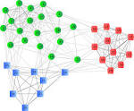
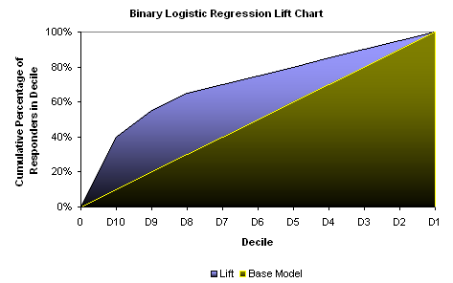

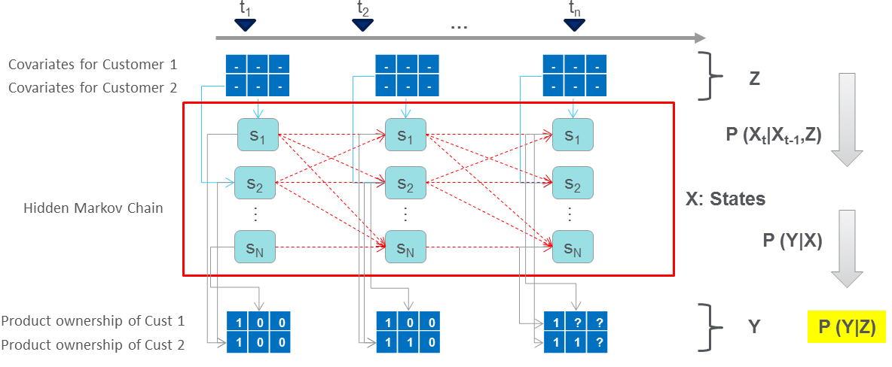
Consumer Analytics Group Analytic Capabilities
Enable core analytical toolkit coupled with advanced solutions and focus on Global priorities
Traditional
Innovative
Limited cutting-edge analytics
Limited effort to Digital/
Limited advanced quantitative science
Core set of analytic tools with New statistical models and new advanced techniques
Turnkey business solutions
Price Elasticity and Optimization
Next Best Offer (Latent Markov Modeling)
Response
Χ
Financials
=
Optimal Price
Price for Max Value
% Response Rate
EBT per Responder
Total EBIT
Price
Price
Price

